Slide 1


CLOUD ORCHESTRATION

Slide 2
ENTREPRISE ORCHESTRATION SOLUTION
Advantages
Licensing Costs
Premium Support & Roadmap
Disadvantages
Robustness & Reliability
Scalability
CI/CD implementation
Code reusability
WYSIWYG

Slide 3
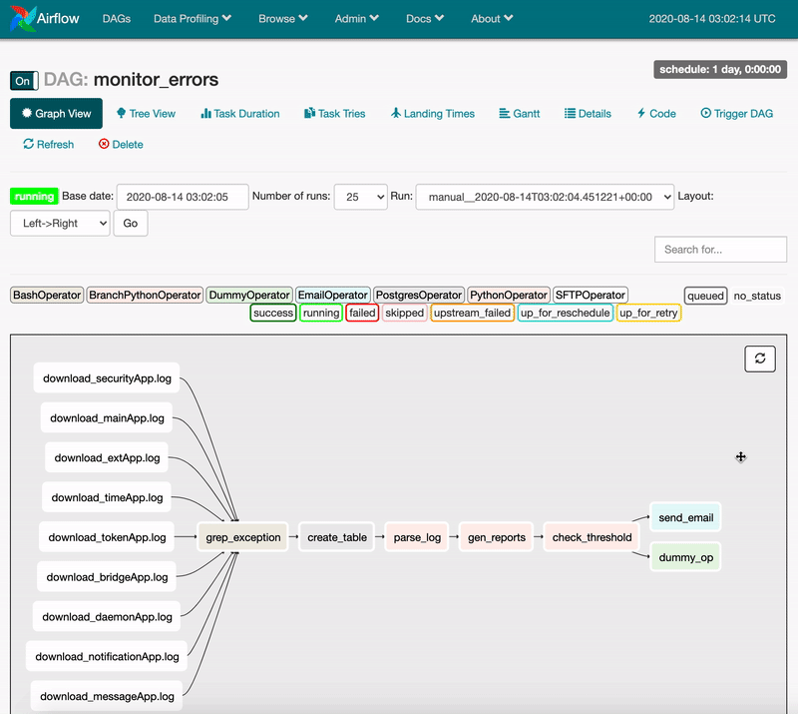



Airflow : a python Framework
Pre-requisites
https://projects.apache.org/committee.html?airflow

Slide 4



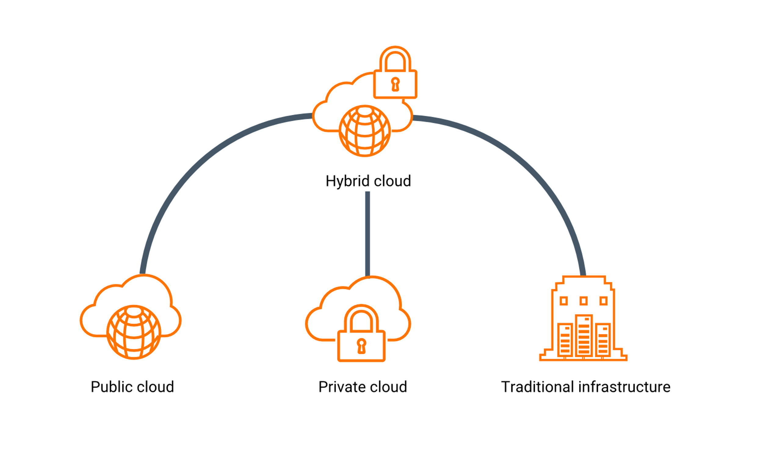

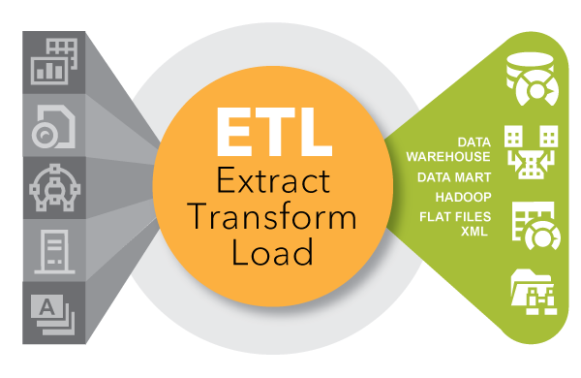
AIRFLOWAAS : USE CASES
IT Workflow
Systems Remediation
AI : Machine Learning pipelines
Traditionnel ELT/ETL

Slide 5
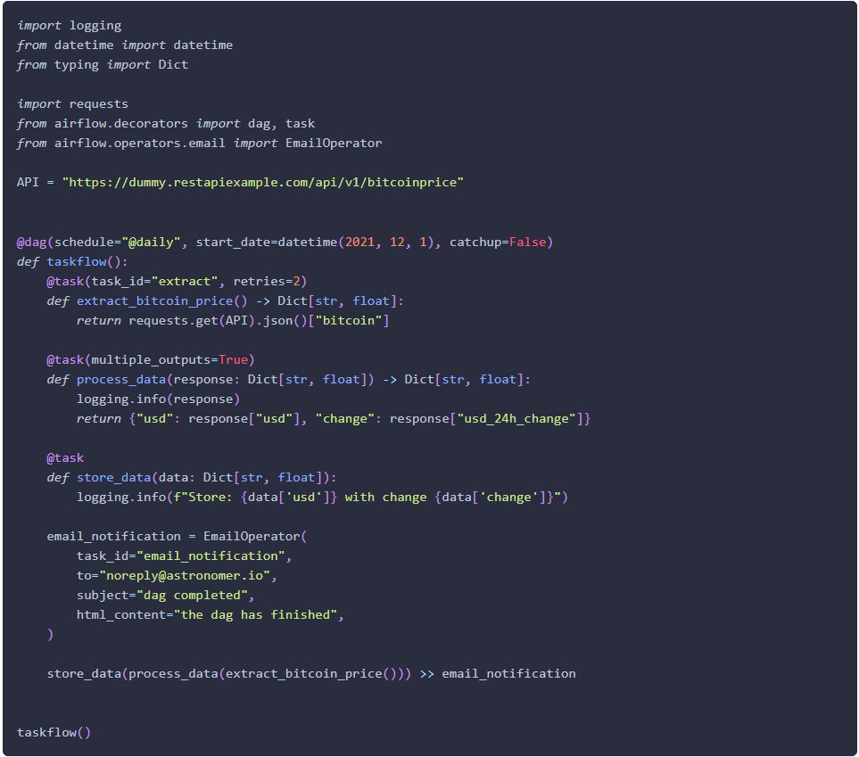
Airflow: a sample dag
1
Imports
Import Python dependencies needed for the workflow
2
Setup
Give the DAG a name, configure the schedule, and set the DAG settings
3
Tasks
Execute an operator or a sensor
4
Ordering
Set the order the tasks should be executed in.
Notes:
What is the solution ?
Open source is a powerful vector for innovation and it's essential for open banking.
Societe Generale is resolutely converting to opensource software.
For SG, it is not only a question of migrating our applications and infrastructure to open source solutions,
but to establish a new mindset by making our IT specialists first-rate contributors.

Slide 6


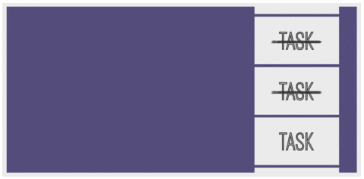






Airflow: HOW IT WORKS ?
Broker
Webserver
scheduler
Airflow Worker
Airflow Worker
Airflow Worker
Webserver
scheduler
Webserver
scheduler
Metadata DB
Backend DB

Slide 7

Cloud orchestration : Service description
On-demand Airflow instance provisioning and management on SG CLOUD Platform.
CUSTOMERS
Product
Hosting
Fully managed Airflow
instance.
100% hosted on Platform services.
GTS
BSC
ITIM
ITEC
…
Making orchestration easy.
Available on Trusted networks.
Based on Apache Airflow open source python framework.
Available on Multiple REGIONS.
End-to-end integration for Platform services.
Hybrid and multi-cloud environnements eligible.
Regional resource pattern.

Slide 8

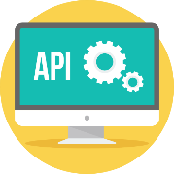



Cloud Orchestration: HOW DOES IT WORKS?
DIN / Control Plane API
{IAM}
CRUD
CONTROL PLANE
RESOURCE PLANE
Manage instances
{Applicatif accounts}
Manage workflows
AIRFLOW INSTANCE

Slide 9
AIRFLOW @ SG-
O
C
nboarding
ommunity
M
anaged

Slide 10




Community
Managed
Onboarding
LIVE DEMO
PROVIDE DEV DOCKER STACK
WORKSHOPS

Slide 11


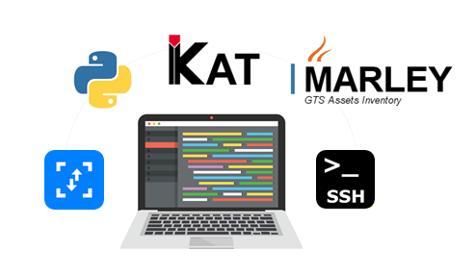
Community
Managed
Onboarding
TUTORIAL
SG COMMON ARTIFACTS
DEV STANDARDS

Slide 12

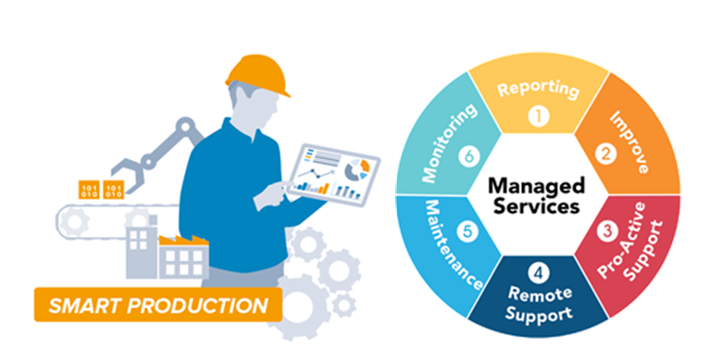
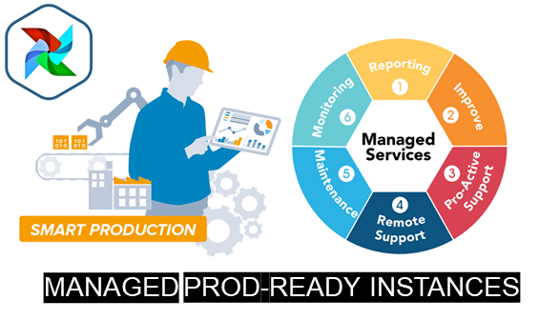
Community
Managed
Onboarding

Slide 13
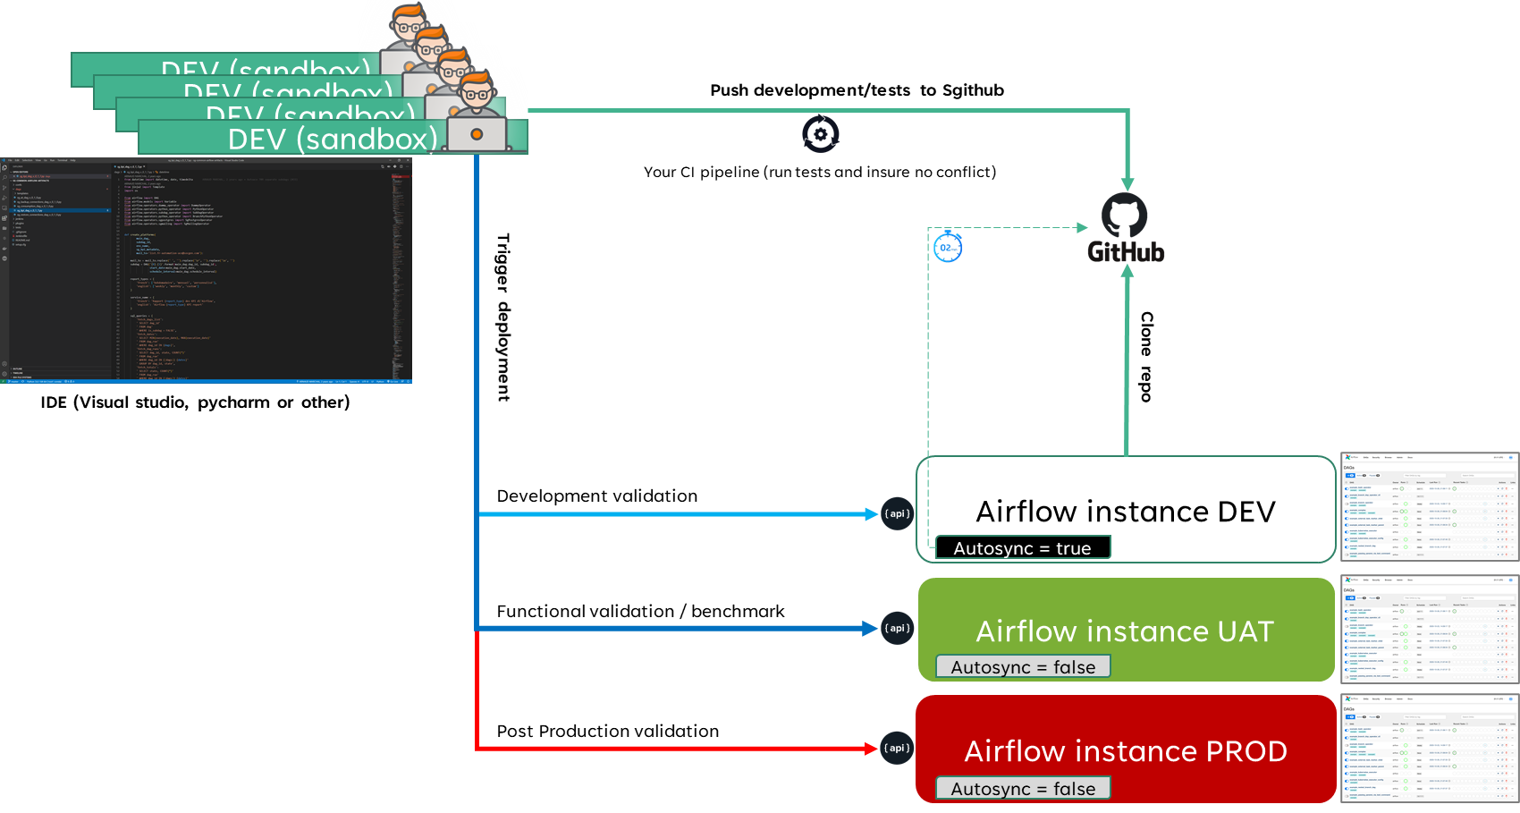
USER JOURNEY
EXAMPLE OF USER JOURNEY
1
2
3
4
5

Slide 14


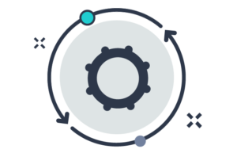


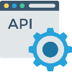






Deploy IMMUTABLE ARTEFACT
AIRFLOW Resource Plane
1
/deployments
Controller
AIRFLOW SERVICES
DAG/Plugins
BUILD
DEV2PROD
2
Clone up to 3 git repo
Containers Rolling update
PY Packages
Copy up to 3 S3 buckets
Install py packages
Install sys packages
SYS Packages
DEPLOY
3
Push $env_variables
ENV VARS

Slide 15
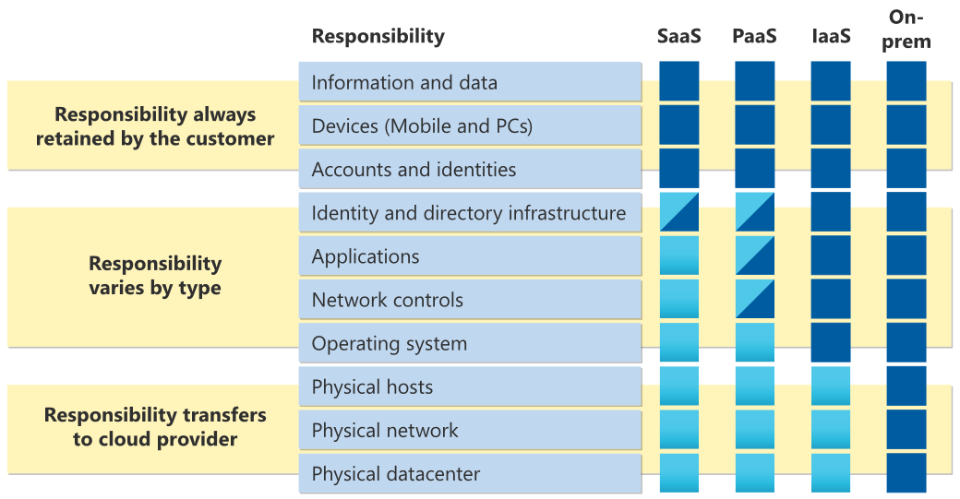
EXPLOITATION MODEL
CSP
SHARED RESPONSABILITY
Cloud Platform
Customer Platform
Cloud Platform
Customer Responsability
-
Customization
+

Slide 16


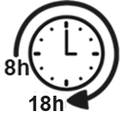





EXPLOITATION MODEL
SUPPORT
Cloud Orchestration (CP+RP)
How to contact ?
FR-PAS-DVF-AIRFLOW-SUPPORT
MONDAY-FRIDAY
DO IT NOW PORTAL
OUT OF OFFICE HOUR SUPPORT
TEAMS GROUP
MONITORING
Aerohealth
Mail alerting
Autonomy using our API (recover action)
MonitoringAAS Mail alerting or SMS
Customer dashboard
LOGS on kibana
Customer
Cloud Platform

Slide 17




RESILIENCY: MULTI-AZ (Active/PASSIVE)
A
ACTIVE
P
PASSIVE
*
LOCAL
Share nothing model
DC - eu-fr-paris 1
A
KUBE
DC - eu-fr-north 1
*
KUBE
PG
PG
active
active
Replication
Queue Mirroring
Replication
Queue Mirroring
PG
PG
Standby
Standby
P
DC - eu-fr-paris 2
PARIS
NORTH (SECLIN)

Slide 18

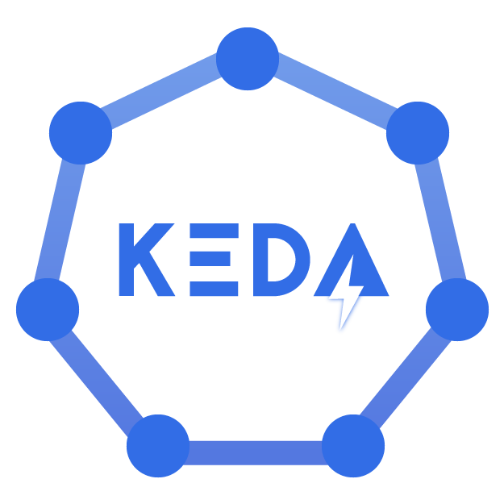
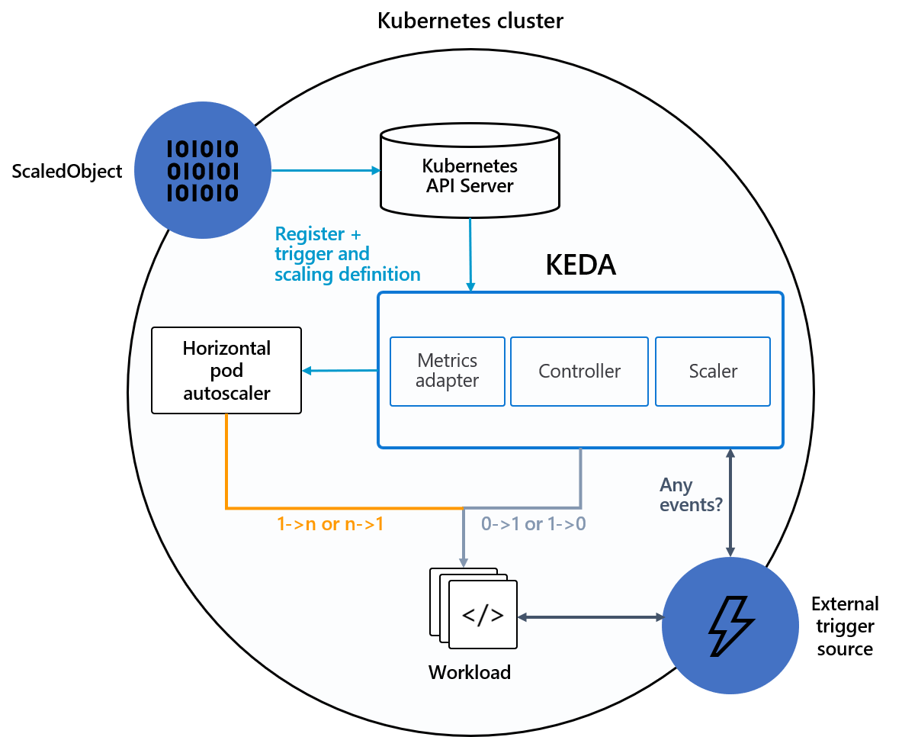
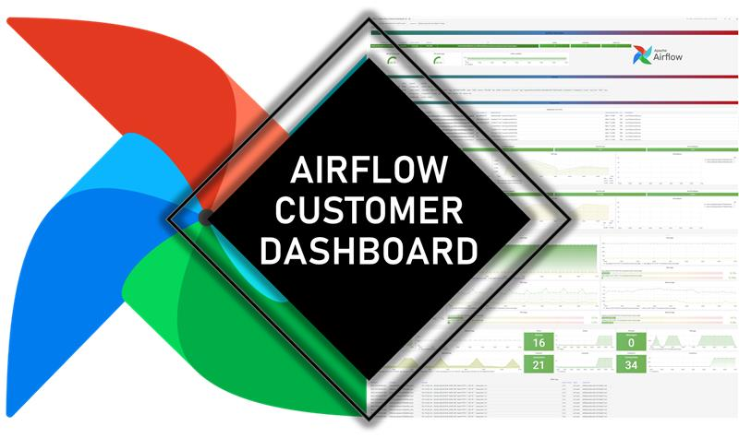
Scalability (Today vs Tomorrow)
Scalability on demand
TODAY
NEXT YEAR

Slide 19




EXPLOITATION MODEL
OPEN SOURCE UPSTREAM
https://airflow.apache.org/community/
Astronomer support contract (limited to 10 tickets/month)
Astronomer blog/registry

Slide 20
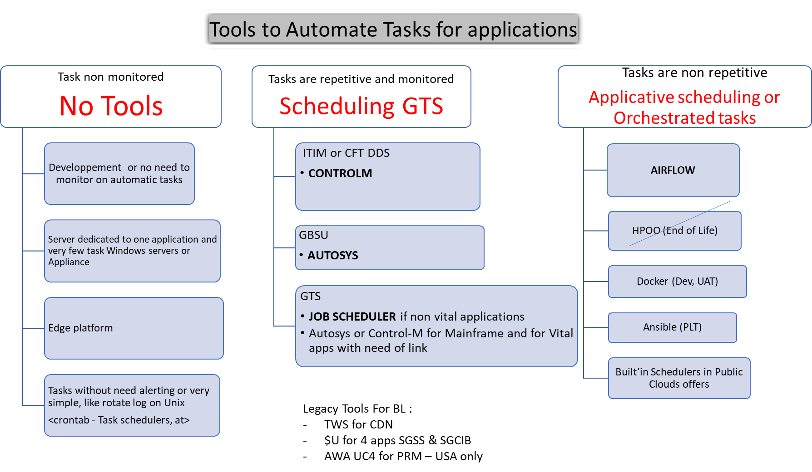



DECISION TREE
AIRFLOW & LEGACY SCHEDULING TOOLS
Scheduling and orchestration
as code (python)

Slide 21
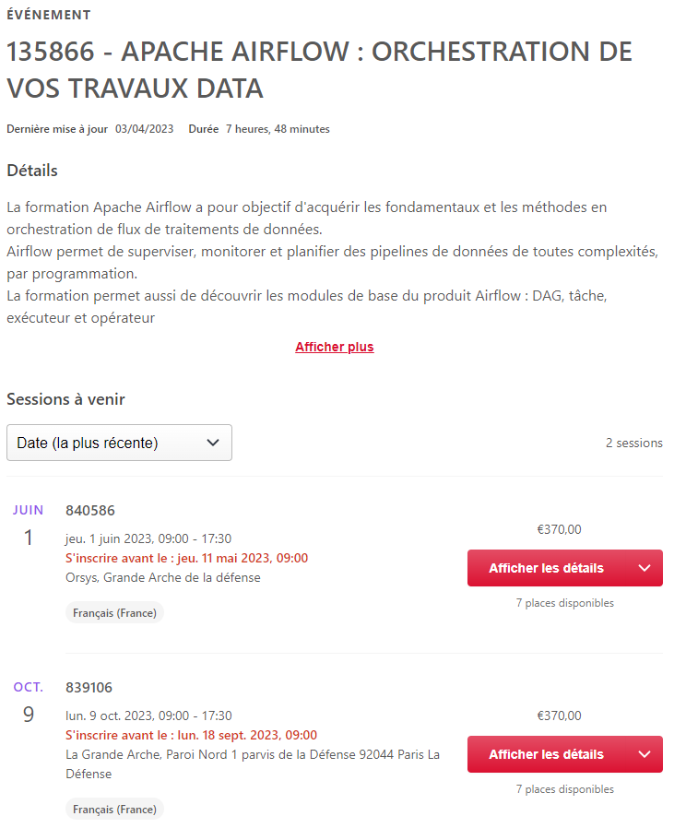

TRAINING

Slide 22

EXPLOITATION MODEL
MAINTENANCE WINDOW (WIP)
https://documentation.cloud.socgen/internal/platform_standards/rest_api/maintenance_windows.html
Maintenance operations can have the following effects on your environment:
Changing some parameters of your environment or upgrading to a newer version might not be possible temporarily.
Direct SQL queries to the Airflow database might take longer than usual and might require retrying.
Airflow UI might be temporarily not available
Some Airflow tasks can be interrupted. After the maintenance operation completes, Airflow schedules retries for these tasks (if not configured otherwise).
You can still run your DAGs during maintenance windows, as long as it is acceptable that some tasks can be interrupted and retried. If you run DAGs during maintenance windows, make sure that you enable task retries. You can configure task retries at the Airflow configuration, DAG, or task level.

Slide 23
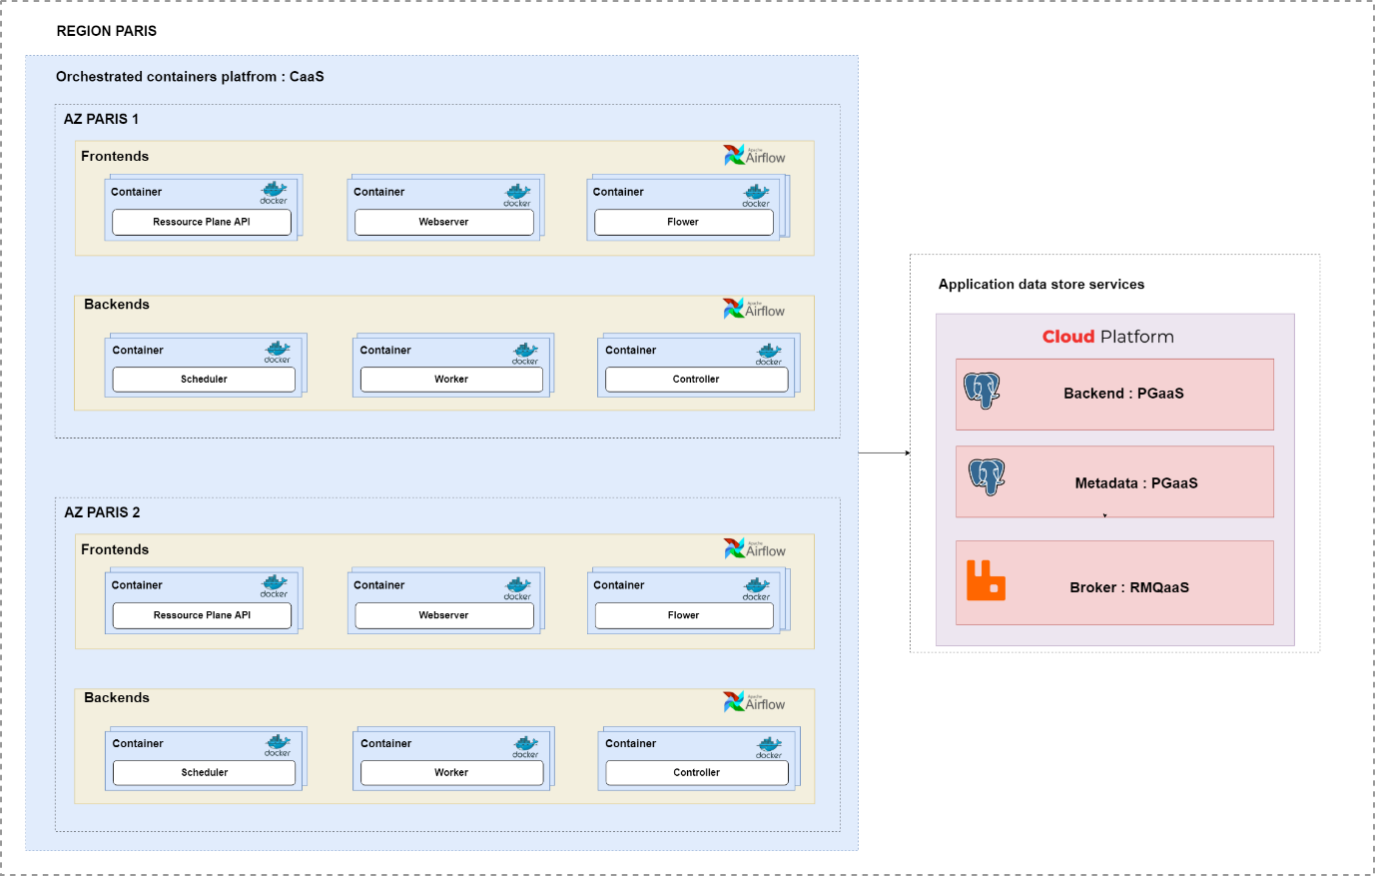
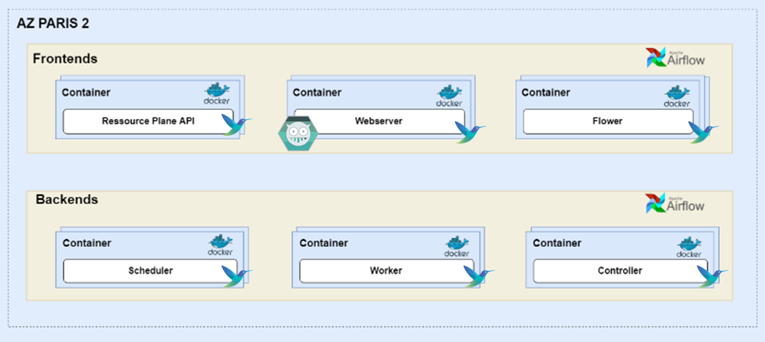
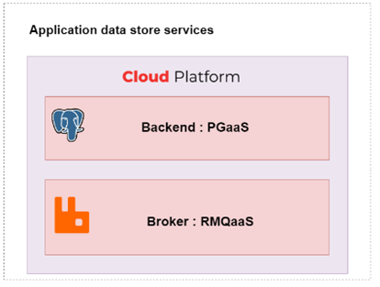


RESOURCE PLANE : HLD HOSTING

Slide 24







PUBLIC/HYBRID :
 | Service/Features | VERSION | Monitoring | UI | CLI/API | LOG | Secrets | CI/CD | Scalability | UAM | Hybrid | SEC ASS | Pricing (Small) | REGION
PUBLIC | Cloud Composer | Airflow 2.4.3 |  |  |  |  |  |  |  |  | Public |  | 450€/Month* | EU
 | Astronomer | Airflow 2.5.3 |  |  |  |  |  |  |  |  | Hybrid |  | 550€/Month* | EU
 | Azure DataFactory | ? Feb 2023 |  |  |  |  |  |  |  |  | Public |  | ~500€/Month* | EU
 | MWAA | Airflow 2.5.1 |  |  |  |  |  |  |  |  | Public |  | 615€/Month* | EU
HYBRID | CLOUD ORCHESRATION | Airflow 2.4.3 |  |  |  |  |  |  |  |  | Hybrid |  | 450€/Month | EU
Available and respond to SG expectation
Available but don’t respond to expectation or limited
*
PUBLIC cloud pricing doesnt count data transfert fees

Slide 25
BEST PRACTICES/LIMITS
Airflow is not streaming tool
Airflow is open source, so please get benfit of community intelligence.
Upgrade your environment (every 3~6months)
Resize your environment based on your consumption
Use operators and build your python packages (TDD)
Use retries and timeout

Slide 26

USE CASE TIME ☺

Slide 27
X-One Presentation
Main GBIS deal booking and processing application
Created to replace 20 old ones

Slide 28





X-ONE
USERS
TRADE VOLUME
Front Office, Financial Engineers
Middle Office, Back Office (OTC)
Market Risk,
~60 Elec. Trade Connector
100+ Applications enslaved to X-ONE
400 Functional Services
X-ONE COVERAGE
730 Traders
575 Sales
110 Engineers
1200 Oper
350k Trades/day
15Mio Active Trades (FIC)
5000 Active Users
1000 live connected users
PRODUCT COVERAGE
TECHNOLOGY
+7Mio lines of code
310K Unit Tests/15K NRT
300 Developers
4000 deployable services
300+ use case on APIs
100 APIs
~5Mio API calls / day
GLOBAL ACTIVITY
8 Asset Classes
FX, FXO, Listed Fixed Income, IRD, CDV, SecLoan, CashLoan, EQD
1300 Instruments
450 Payoffs
50 Legal Entities
15 Time Zones

Slide 29

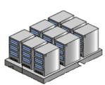
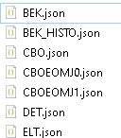

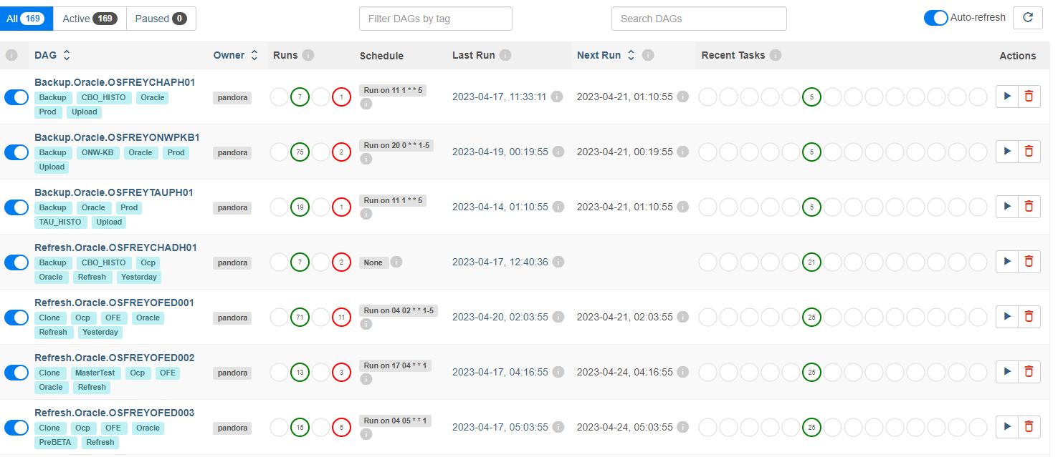




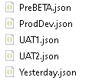
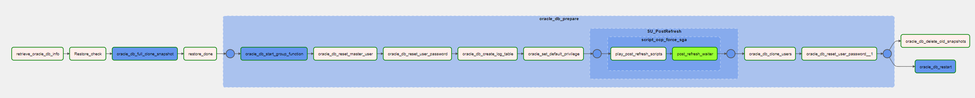
X-One Infrastructure overview
X-One Production
X-One Development Database Management
X-One Database Configuration
JEKINS - X-One Database Lifecycle
X-One Desktops
Services
Batch
Global applications config
Api
N
Data Services
1
X-One Environment
Databases Production
Oracle
PostgreSql
Sybase
List of Db

Slide 30

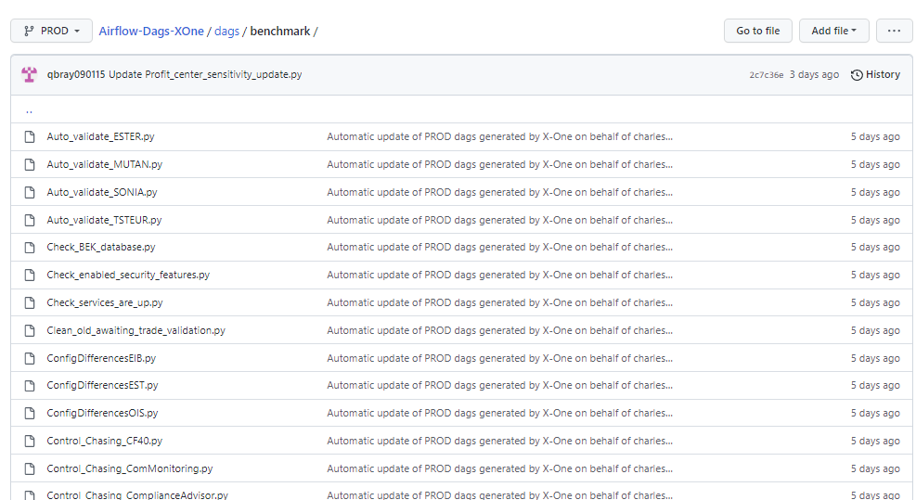
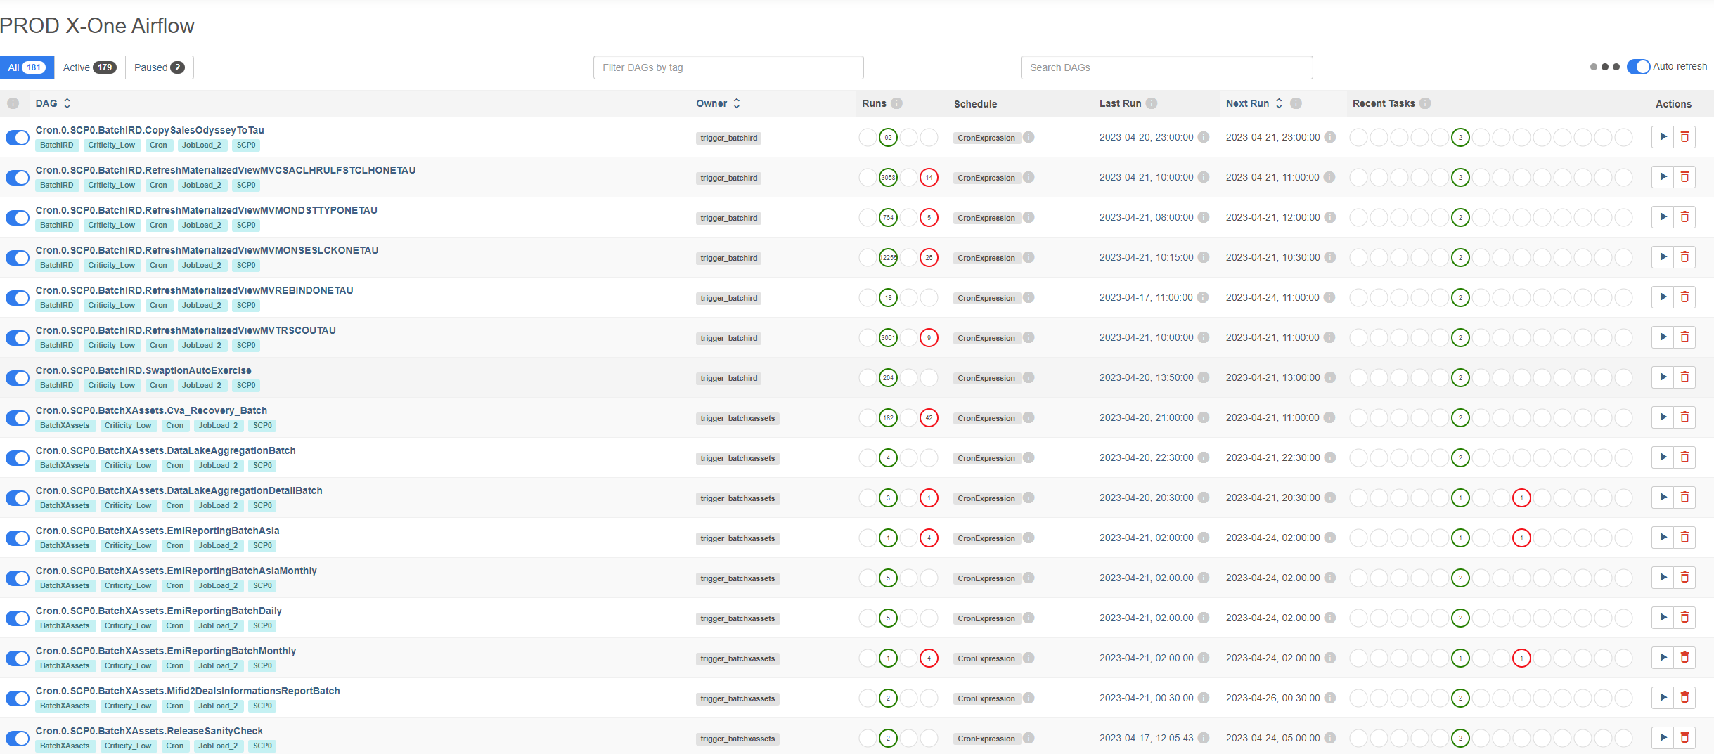
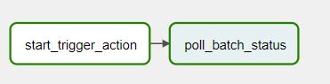
X-OnE BATCH with AIRFLOW
X-One Production
X-One Development Database Management
X-One Batch DAG
JEKINS - X-One Database Lifecycle
X-One Desktops
AirflowManager
BatchManagerApi
BatchServiceA
BatchServiceB
Batch
Batch
X-One Airflow TimeTable
Batch
Batch
Batch
Data Services

